Slide 1
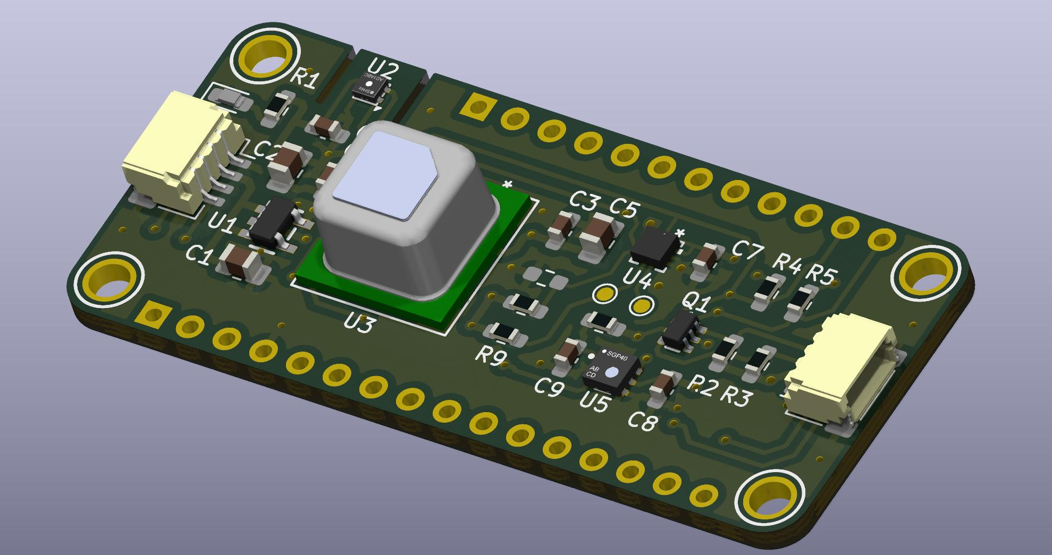
Feather Weather Wing

Slide 2
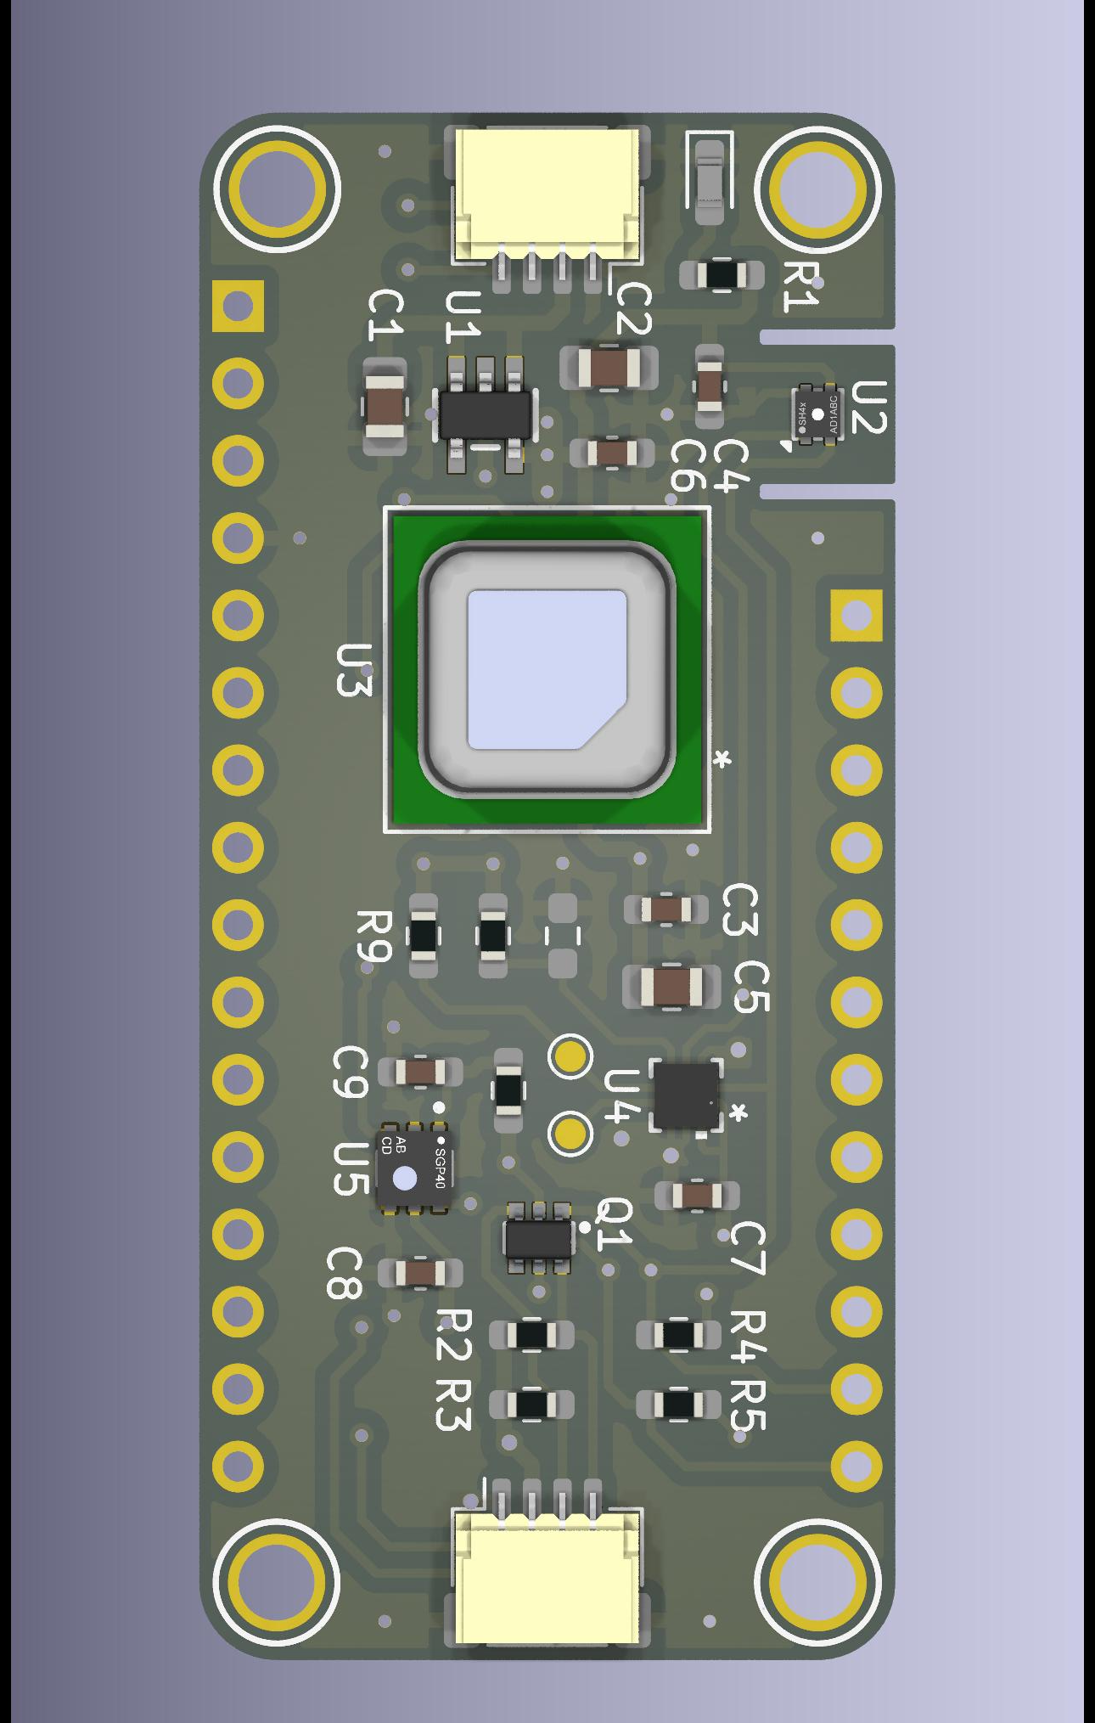
Feather Weather Wing: What is it?
It is a 0.9-inch x 2.0-inch circuit board that combines four environmental sensors in the Feather Wing form factor.
Sensirion SHT45 – Humidity & Temperature
Sensirion SCD41 – CO2, Temperature, & Humidity
Benefits from an atmospheric air pressure input.
Sensirion SGP40 – Indoor Air Quality
Benefits from a humidity input.
Bosch BMP390 – Atmospheric Air Pressure
4 Layer PCB
Designed using KiCad 9.0
PCB fabricated by OSHPARK

Slide 3
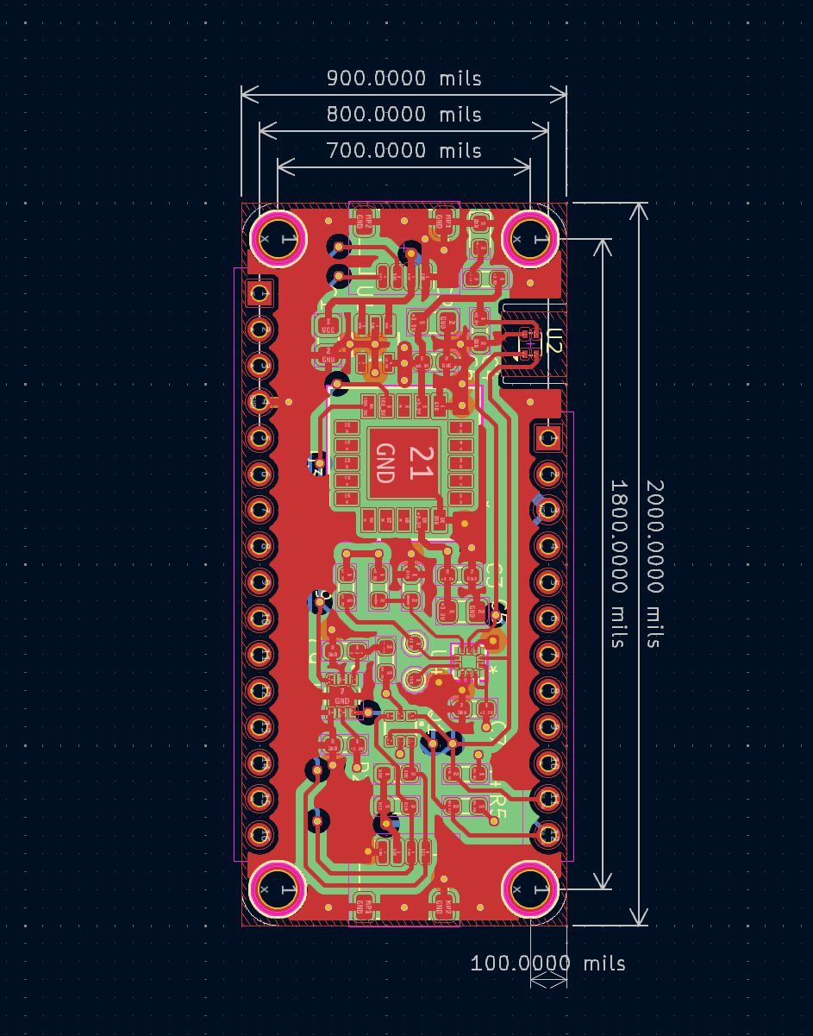
Feather Specification
The classic size is 0.9-inch X 2.0-inch with a 0.1-inch hole in each corner.
Created by Adafruit.
Can be wider or longer.
Feather Mainboards have a microcontroller.
Accessory boards are called Feather Wings.
Boards stack using a 1x16 header and a 1x12 header.
Link: Feather Specification

Slide 4
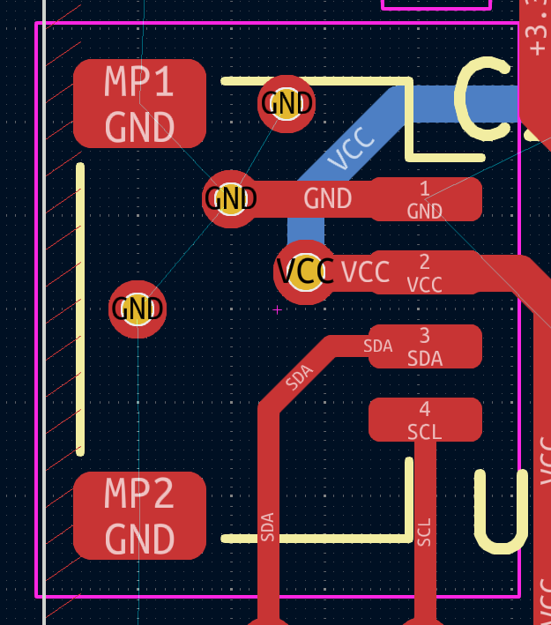
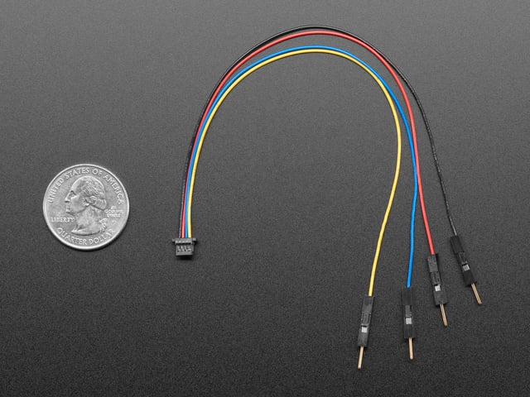
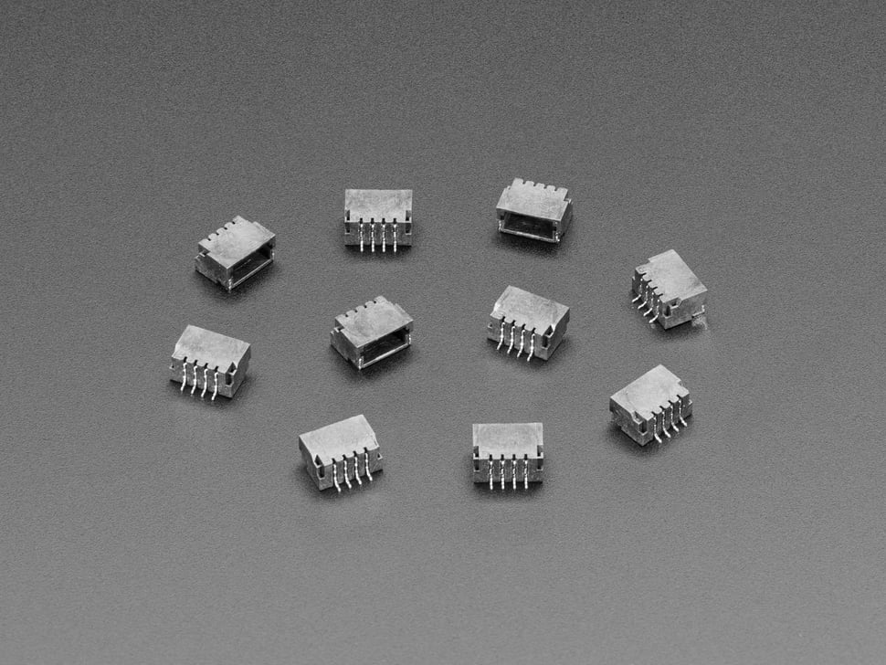
STEMMA QT
4-Pin 1.0mm pitch JST SH Connector: SM04B-SRSS-TB
Black for GND
Red for VCC
Blue for SDA
Yellow for SCL
VCC is 3V – 5V
Level shifting is used to accommodate 5V I2C logic.
Created by Adafruit
Very similar to the Sparkfun QWIIC system with the addition of level shifting and an LDO.
https://www.sparkfun.com/qwiic
Adafruit STEMMA QT

Slide 5
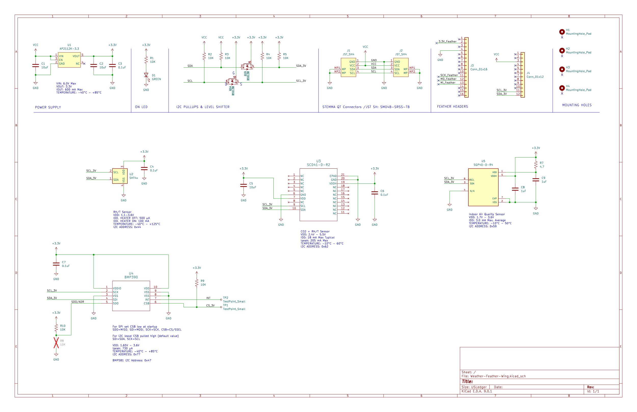
Schematic

Slide 6
Bill Of Materials (BOM)
Index | Reference | Description | Manufacturer Part Number | Manufacturer Name | Quantity | DNP
1 | C1,C2,C5 | CAP CER 10UF 10V X7R 0805 | C0805C106K8RACTU | KEMET | 3
2 | C3,C4,C6,C7 | CAP CER 0.1UF 10V X7R 0603 | C0603C104K8RACTU | KEMET | 4
3 | C8,C9 | CAP CER 1UF 16V X7R 0603 | C0603C105K4RACTU | KEMET | 2
4 | D1 | LED GREEN DIFFUSED 0603 SMD | KT EELP41.12-S2U1-25-2X4X-5-R18 | ams-OSRAM USA INC. | 1
5 | J1,J2 | CONN HEADER SMD R/A 4POS 1MM | SM04B-SRSS-TB | JST Sales America Inc. | 2
6 | J3 | Conn_01x16 | - | - | 0 | DNP
7 | J4 | Conn_01x12 | - | - | 0 | DNP
8 | Q1 | MOSFET 2N-CH 50V 0.2A SOT363 | BSS138DWQ-7 | Diodes Incorporated | 1
9 | R1,R2,R3,R4,R5,R9,R10 | RES SMD 10K OHM 1% 1/10W 0603 | CRCW060310K0FKEA | Vishay Dale | 7
10 | R7 | RES SMD 4.7 OHM 1% 1/10W 0603 | CRCW06034R70FNEA | Vishay Dale | 1
11 | R8 | RES SMD 10K OHM 1% 1/10W 0603 | - | - | 0 | DNP
12 | U1 | IC REG LINEAR 3.3V 600MA SOT-25 | AP2112K-3.3TRG1 | Diodes Incorporated | 1
13 | U2 | DIGITAL RH/TEMP W/FILTER | SHT45-AD1F-R2 | Sensirion AG | 1
14 | U3 | SENSOR AIR QUALITY I2C OUTPUT | SCD41-D-R2 | Sensirion AG | 1
15 | U4 | SENSOR 18.13PSIA 10LGA | BMP390 | Bosch Sensortec | 1
16 | U5 | SENSOR AIR QUALITY I2C OUTPUT | SGP40-D-R4 | Sensirion AG | 1

Slide 7




PCB Copper Layers
Top: Signal /PWR /GND
Inner 1: 3.3V PWR
Inner 2: GND
Bottom: Signal /PWR /GND

Slide 8
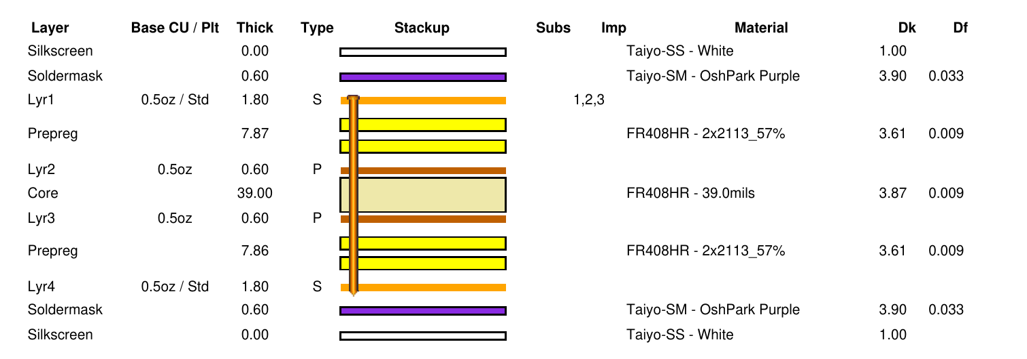
Stackup: Four Layer OSHPARK

Slide 9
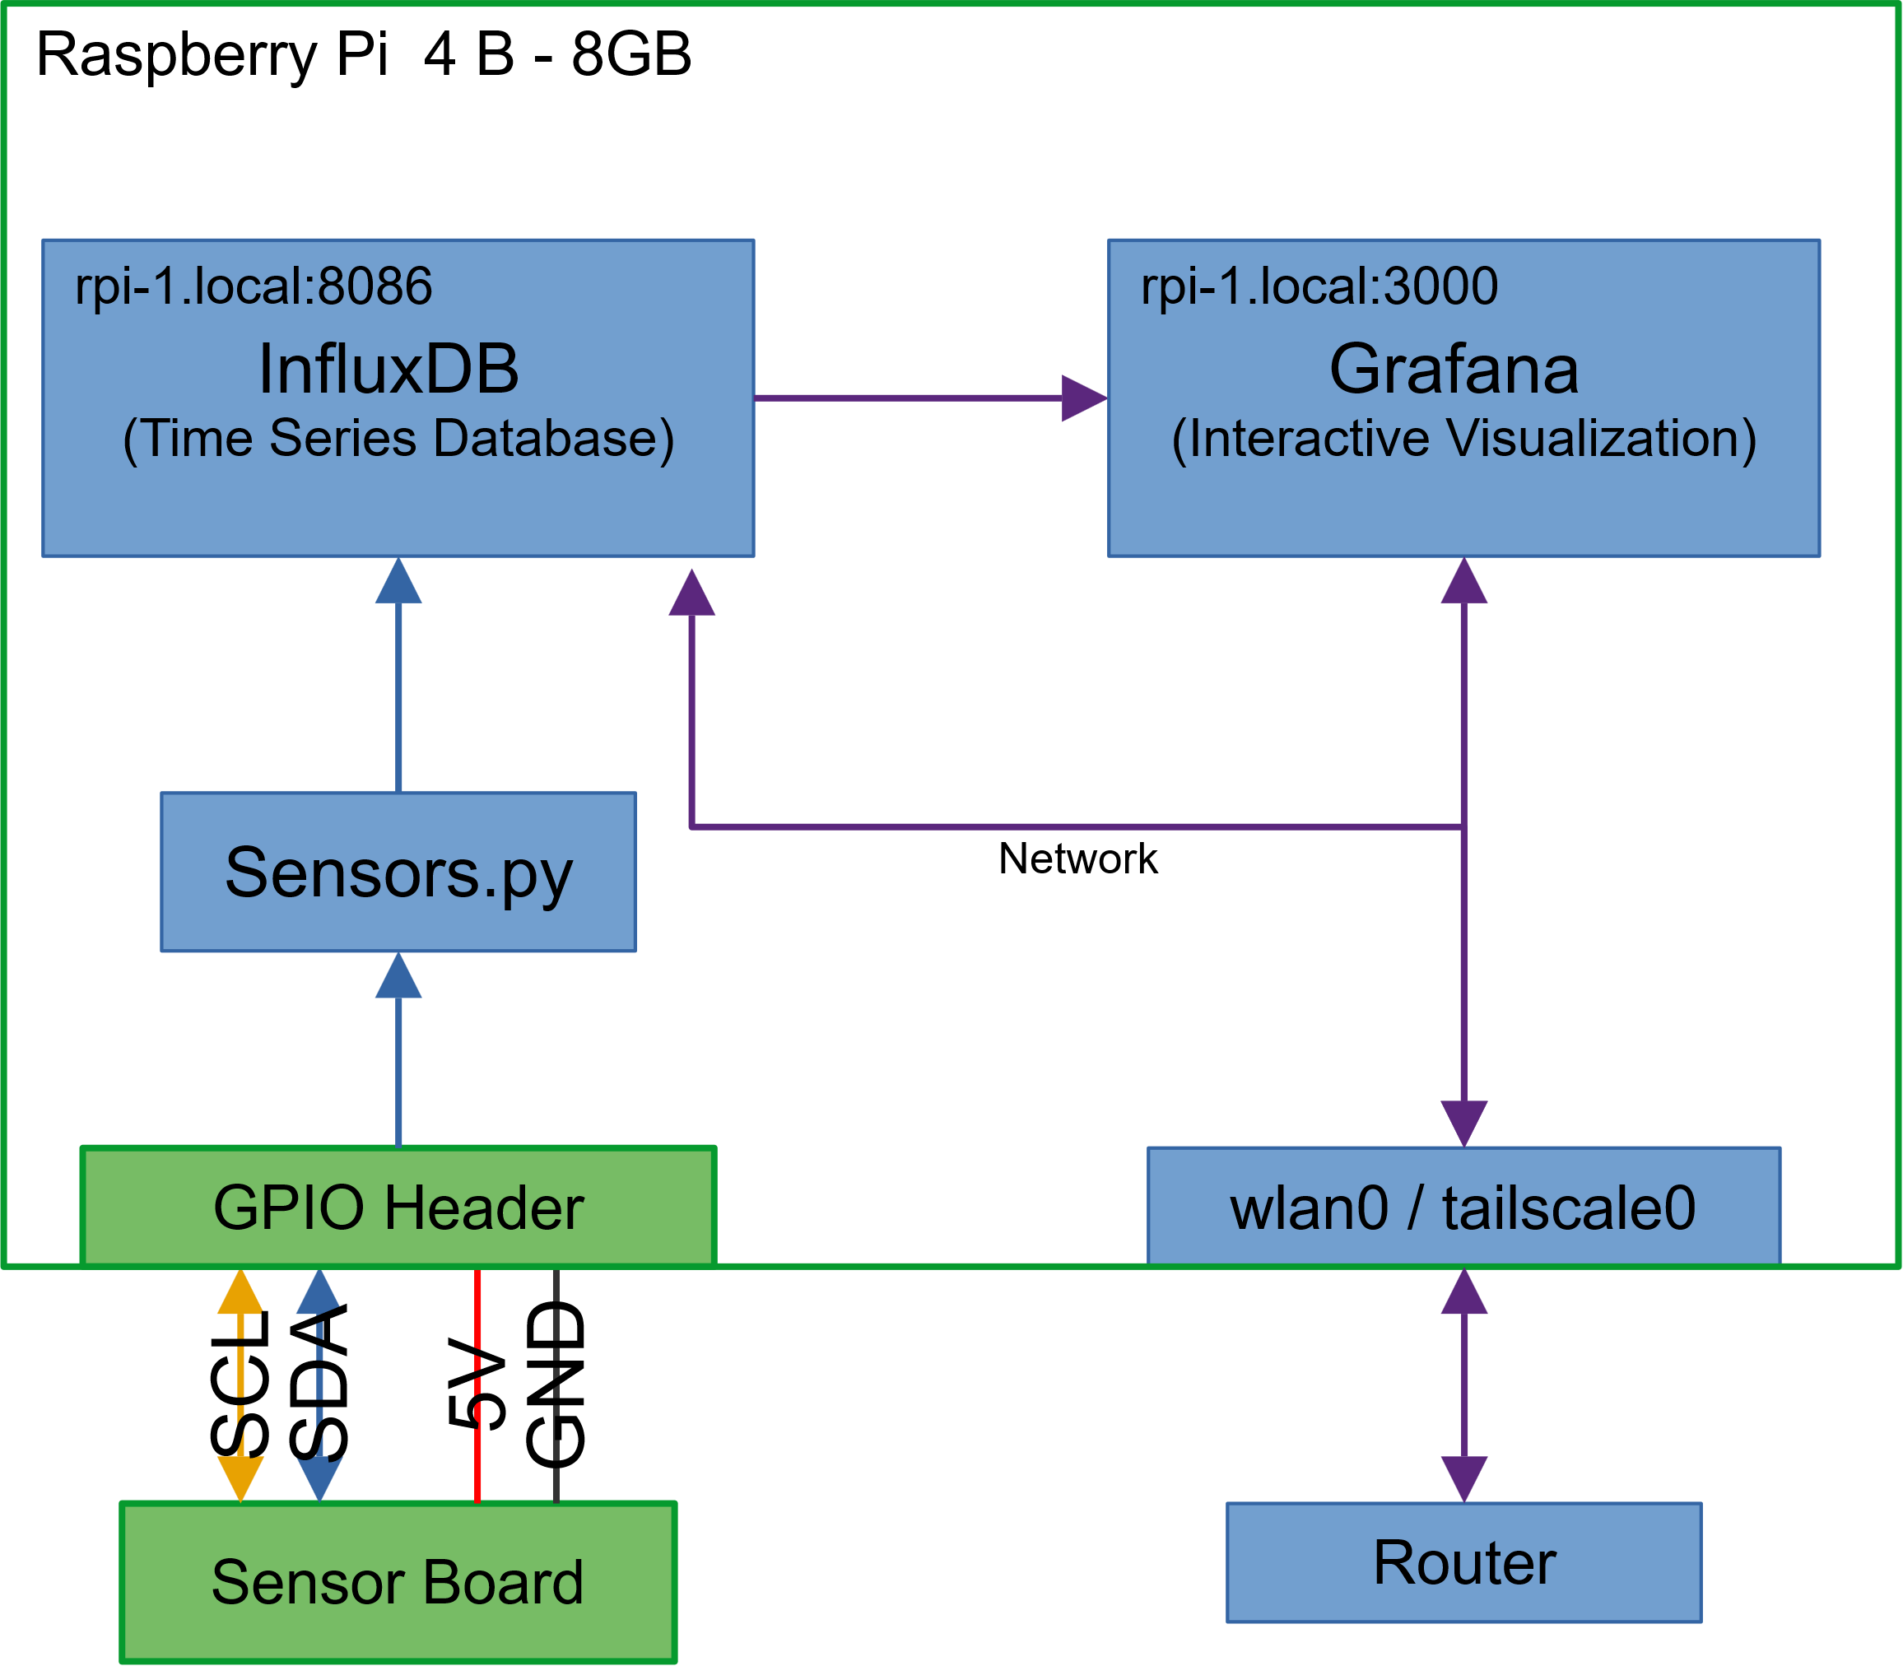
Data Logging and Visualization
Sensor board is connected to the 40-pin expansion header on a Raspberry Pi
Data is read every minute and stored in an InfluxDB time series database.
The data can be queried and displayed using Grafana.
Grafana dashboards are accessible from a web browser on any device on the same network.

Slide 10
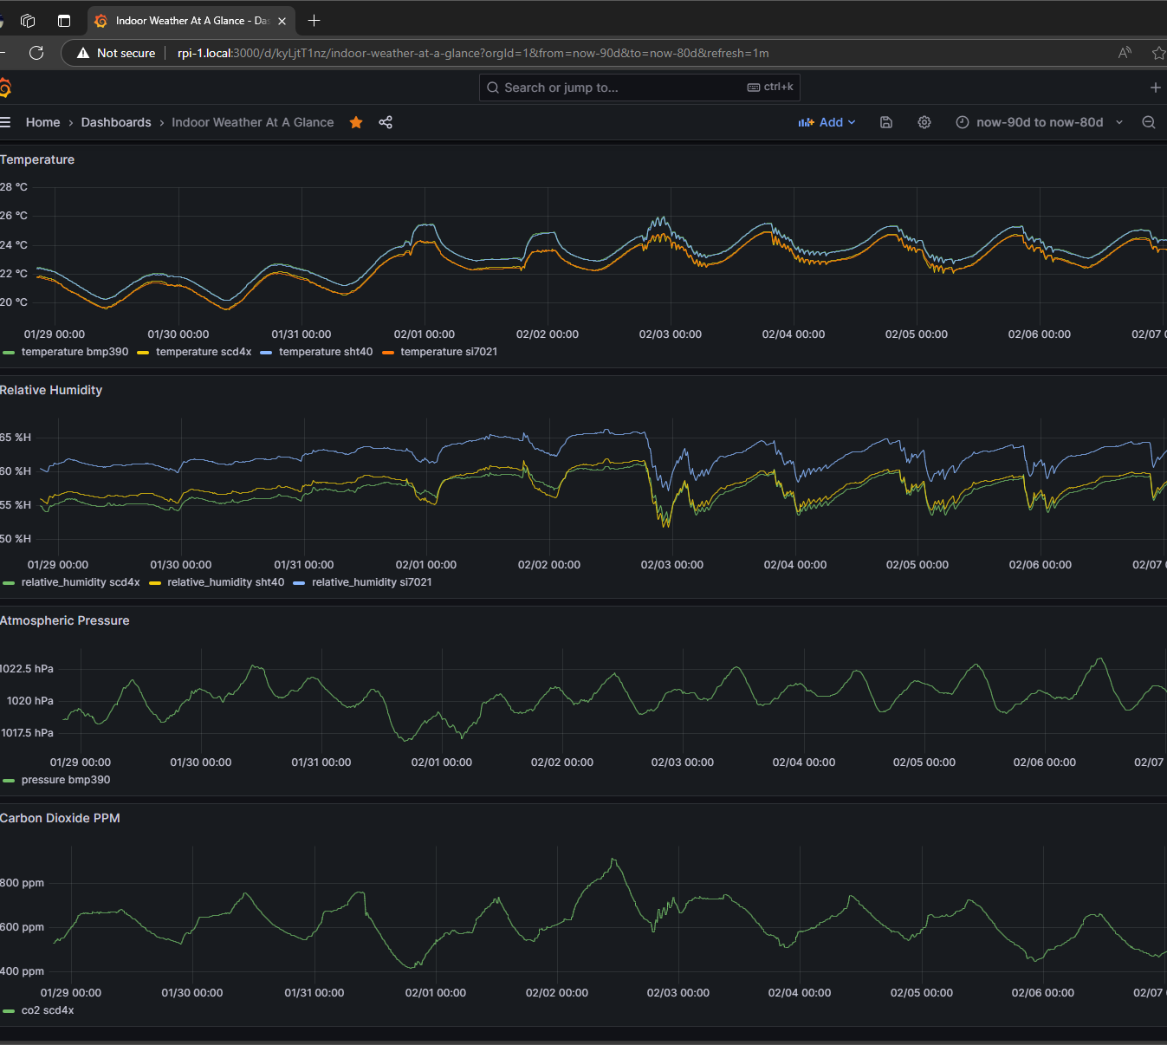
Grafana Dashboard
Data visualization

Slide 11
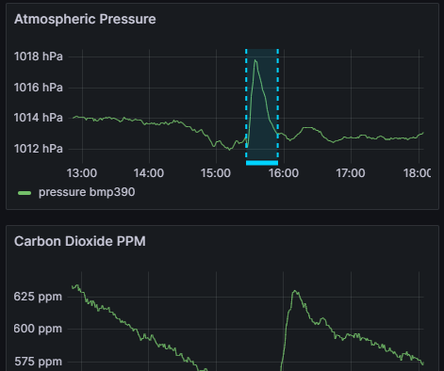
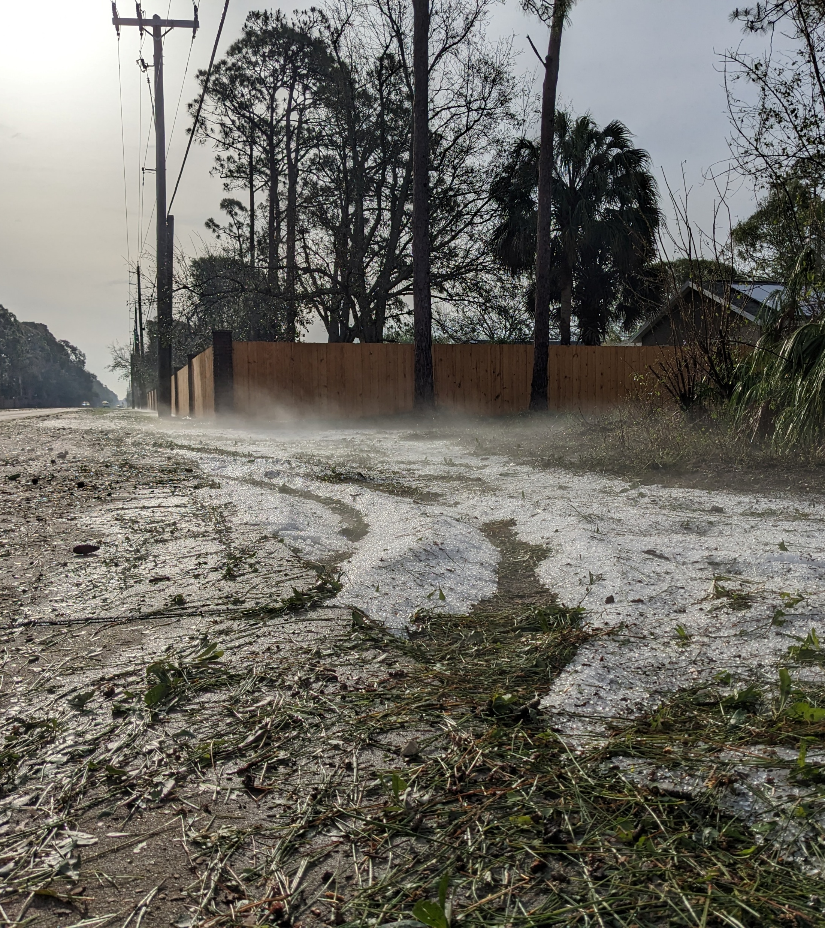
Grafana Dashboard
HUGE Hailstorm on April 27, 2023

Slide 12
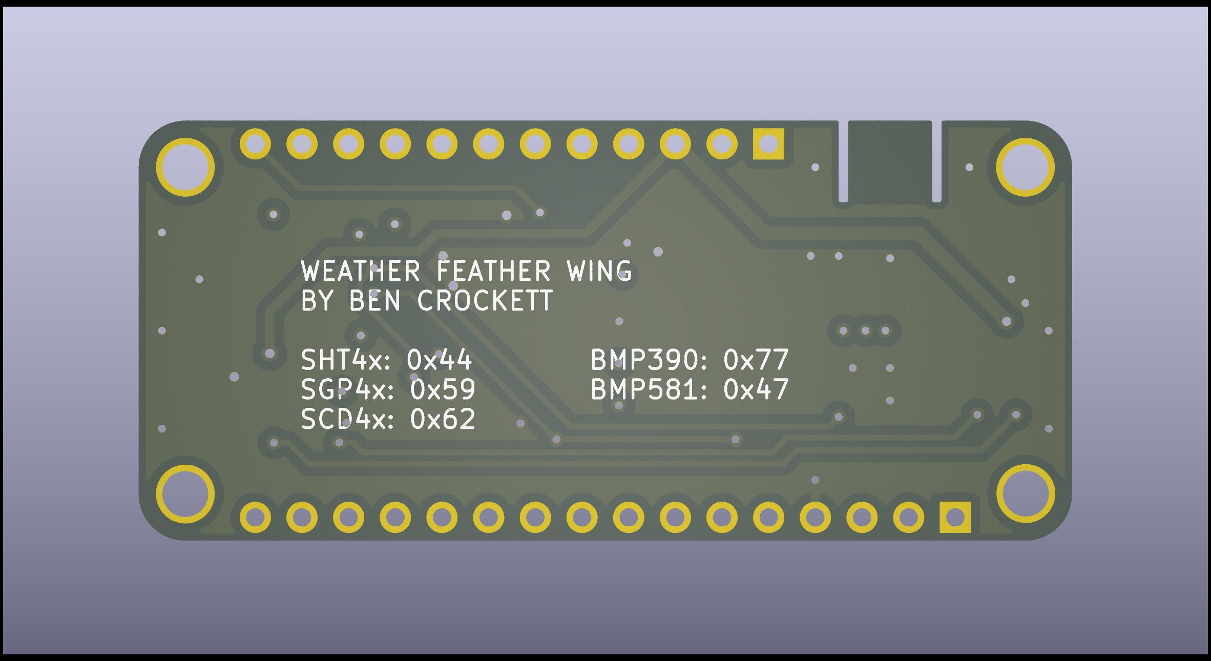
THE END Ben Crockett

